Slide 1

warning
The CTU constitution has been around for a long time and structures and procedures of the CTU express some of the best lessons of our union tradition. There are changes that we need to bring our structures up-to-date, but we should proceed with caution. We are not trying to rip up our constitution and start over!

Slide 2

Ctu constitutional change three main reasons
Unified Voice for CPS and Charter Educators
Improve Structure and Governance
Deep and Democratic Discussion of the Type of Union We Want

Slide 3

1. Unified voice of cps and charter educators
Amend constitution to allow for a charter division.
Integrate Local 4343 into CTU so that new members understand and fit in with the culture, democratic practices, structures and fighting stance of the CTU.
Allow us to use our collective power politically.

Slide 4

1. Unified voice of cps and charter educators
Lead a joint contract fight across the entire charter industry in the Spring 2018 through the Fall of 2018.
Unionize more charters – build up level of benefits in CTU and
charter contracts.
Create democratic structures to ensure decision making ability
and contributions from the charter division.

Slide 5
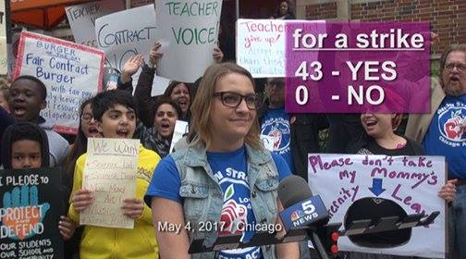
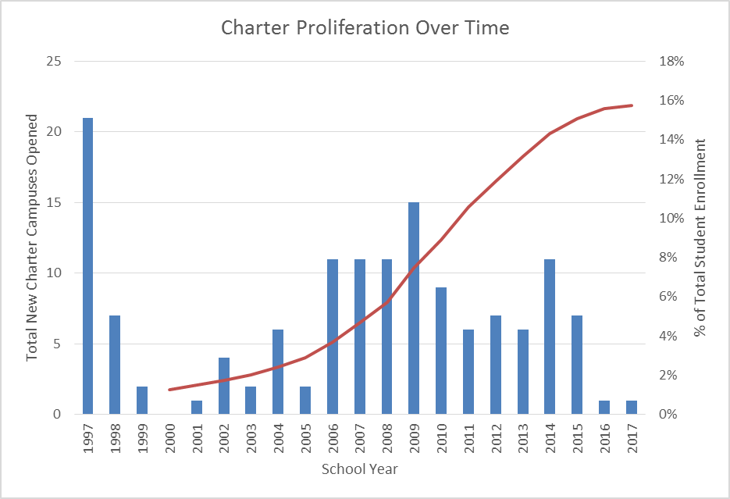

Notes:
We’ve slowed proliferation, are ideologically aligned, increased praxis and militancy … now time to come together.

Slide 6
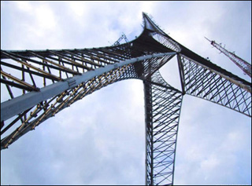
2. Improve structure and governance
Lower dues structure for cadres, members on leave and day to day substitutes to make it easier for them to be CTU members.
Retired members’ dues will increase to correspond with inflation since there has been no change in their dues for decades.
Each school will have at least one voting delegate, no matter if there are less than 20 members at the school.
Give members a way to have a temporary replacement delegate for delegates who are on extended leave.

Slide 7
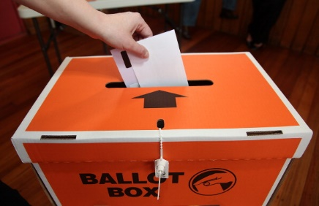
2. Improve structure and governance
Add clinicians as a functional group on the Executive Board.
Add representation, dues and governance amendments for Charter Division.
Executive Board duties for the Chicago Teachers Union Foundation are incorporated in the CTU Constitution By-Laws. (Changing the CTUF By-Laws and incorporating documents requires a separate process)
Change District Supervisors to District Organizers and align their regions to CPS organization of schools.

Slide 8

3. Deep and democratic discussion of the type of union we want
Strengthen internal democracy, respond to and represent the voice of the members and ensure functions of the union are transparent and accountable to the membership.
Strengthen local school governance.
A union that fights for Bread & Butter issues, organizes around teaching and learning issues and organizes for social justice in our community and through our curriculum.

Slide 9
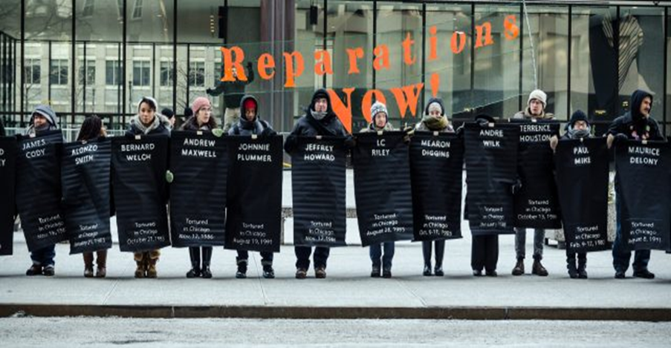
3. Deep and democratic discussion of the type of union we want
Strengthen our coalitions with labor and community to advance social, economic and racial justice for our members and our students. (we cannot have robust schools with the forced exodus of families from Chicago that depend on public education)
Grow the CTU model of member and community engagement.

Slide 10
constitutional change referendum
Process and timeline
09-06-17: Present timeline and process for constitutional change referendum, and provide constitutional change recommendations and constitutional change submission form at the September HOD meeting.
09-25-17: Deadline for submission of constitutional change submission forms.
Week of 9-25 Executive Board meets to finalize constitutional amendment proposals for HOD
10-04-17: Present constitutional change recommendations from the Executive Board at the October HOD meeting.

Slide 11
constitutional change referendum
Process and timeline
11-01-17: HOD votes on Executive Board constitutional change recommendations. CTU leadership will recommend the date of the vote to take place during the second week of December. HOD will set the date for the constitutional change vote in the schools.
12-13-17: HOD finalizes details of the constitutional change vote.
Week of 12-11-17: Membership votes on the constitutional change recommendations.

Slide 12
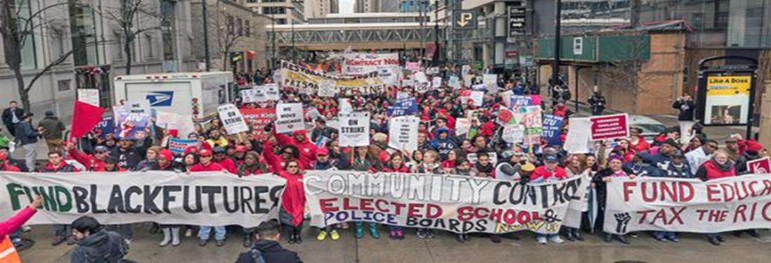
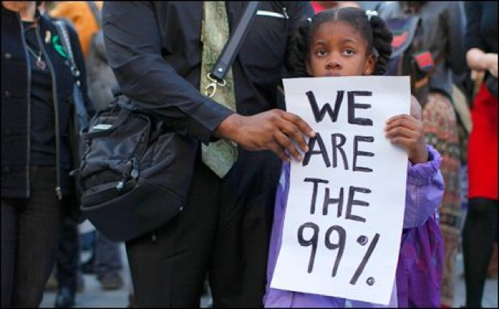

Chicago Teachers union

